Slide 1

PROJECT TITLE : DATABASE MANAGAEMENT SYSTEM OF ITDESK MADIWALA
SUBMITTED TO : PRUTHVI RAJ SINGH
SUMBITTED FROM :
MEGHANA

Slide 2
OBJECTIVE :
SQL facilitates data exploration by enabling users to query and analyze datasets to understand their structure, relationships, and patterns. Data Cleaning: SQL helps in cleaning and preprocessing data by performing operations like filtering, joining, and aggregating to prepare it for analysis.

Slide 3
EXPLANATION :
SQL is a powerful tool for data analysis and manipulation, and it plays a crucial role in various data science projects. Through exploring top SQL database management system project, we have seen how it can tackle real-world challenges and gain valuable insights from diverse datasets.

Slide 4
Technology used in Project :
What is SQL ?
Structured query language (SQL) is a programming language for storing and processing information in a relational database. A relational database stores information in tabular form, with rows and columns representing different data attributes and the various relationships between the data values.

Slide 5
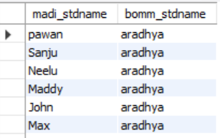
1. Get me the student name of madiwala and bommanahalli
select madi_stdname,bomm_stdname from Institute.madiwala
inner join Institute.bommanahalli
on Institute.madiwala.std_regid=Institute.madiwala.std_regid;

Slide 6
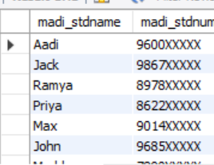
2. Get me the std name with his phone no. of madiwala and bommanahalli
select madi_stdname,madi_stdnumber from Institute.madiwala
group by madi_stdname,madi_stdnumber;

Slide 7

3. Get me count of std who join for Java full stack as well as count
select count(madi_stdcourse)as madi_stdcourse from Institute.madiwala
where madi_stdname="Aadi";

Slide 8
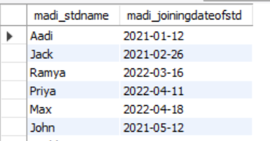
4. Get me joining date of the std who join in bommanahalli with his name
select madi_stdname,madi_joiningdateofstdfromInstitute.madiwala;

Slide 9
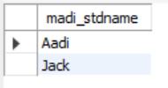
5. Get me student who did IT projects in bommanahalli,madiwala
select madi_stdname from Institute.madiwala
where madi_stdbranch="IT Softwares";

Slide 10
6. Get me performance of particular students marks of 1,2,mid,annual class
select madi_stdname,madi_stdfristtestmarks,madi_stdsecondtestmarks,madi_stdmidportiontestmarks,madi_stdannualcoursetestmarks, madi_stdperformance from Institute.madiwala
where madi_stdname= any (select madi_stdname from Institute.madiwala
where madi_stdperformance="Average" ) ;

Slide 11
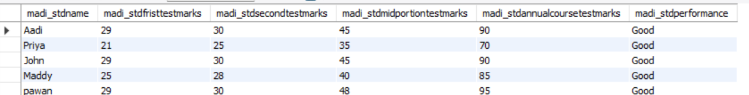
select madi_stdname,madi_stdfristtestmarks,madi_stdsecondtestmarks,madi_stdmidportiontestmarks,madi_stdannualcoursetestmarks, madi_stdperformance from Institute.madiwala
where madi_stdname= any (select madi_stdname from Institute.madiwala
where madi_stdperformance="Good" ) ;

Slide 12
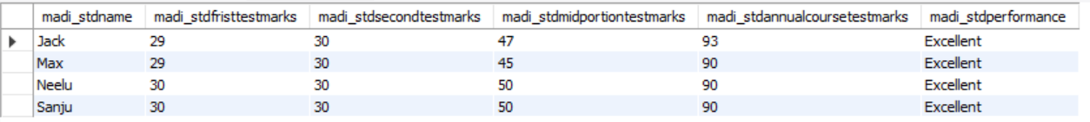
select madi_stdname,madi_stdfristtestmarks,madi_stdsecondtestmarks,madi_stdmidportiontestmarks,madi_stdannualcoursetestmarks, madi_stdperformance from Institute.madiwala
where madi_stdname= any (select madi_stdname from Institute.madiwala
where madi_stdperformance="Excellent" ) ;

Slide 13

7. Get me stds who join stds name along with this place in the month of nov1 to dec1
select bomm_stdname,bomm_stdaddress fromInstitute.bommanahalli
where bomm_joiningdateofstd between '2023-9-01' and '2023-12-01';

Slide 14

8. Get me who are std the name who have avg performance
select avg(madi_stdperformance)as madi_stdperformance,avg (bomm_stdperformance)as bomm_stdperformance from Institute.madiwala
inner join Institute.bommanahalli
on Institute.bommanahalli.std_regid=Institute.madiwala.std_regid;

Slide 15
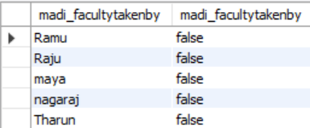
9. Get me facutly name who teaches IT courses such as java,python,web full stack
select madi_facultytakenby ,
case
when madi_facultytakenby='Shruthi' then 'java they will teach' else 'false' end as madi_facultytakenby from Institute.madiwala;

Slide 16

select madi_facultytakenby from Institute.madiwala
where madi_stdcourse='java';

Slide 17
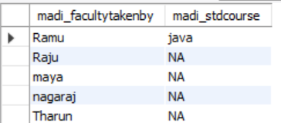
select madi_facultytakenby, case when madi_facultytakenby='Ramu' then madi_stdcourse else "NA" end as madi_stdcourse from Institute.madiwala;

Slide 18
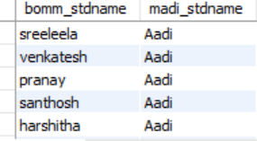
11. Get me the student name of madiwala and bommanahalli
select bomm_stdname,madi_stdname from Institute.bommanahalli
inner join Institute.madiwala
on Institute.bommanahalli.std_regid=Institute.bommanahalli.std_regid;

Slide 19
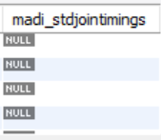
12. Add the madiwala std joining timing in the table
alter table Institute.madiwala
add madi_stdjointiming time;

Slide 20
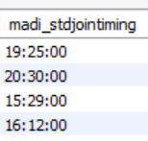
set sql_safe_updates=0;
update Institute.madiwala
set madi_stdjointiming='17:50:00'
where std_regid=110;

Slide 21
Conclusion :
SQL, or Structured Query Language, is a powerful tool for managing and manipulating data stored in relational databases. From its fundamental principles to its diverse real-world applications, SQL plays a pivotal role in various industries and domains

Slide 22
References :
https://caddeskbangalore-bommanhalli.com/

Slide 23
THANK YOU
NAME : A.MEGHANA
COURSE : JAVA FULL STACK

